Slide 1

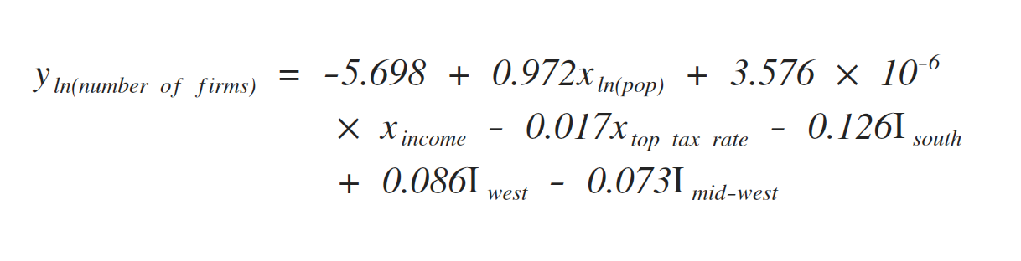
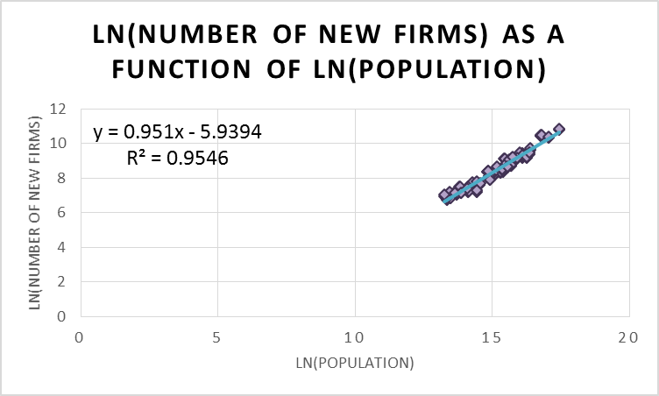
What Drives A Firm to Pick An Incorporating State?
Motivation
Methodology
Final Model
Group 33: Yilong Hu,
Natalie Imamura,
Jiehong Zhen
Delaware has made headlines as a pioneer state in welcoming corporations of all shapes and sizes, where over half of the Fortune 500 are incorporated. This irregularity led us to investigate what factors most influence in which state firms decide to incorporate, through factors including population, corporate tax rate, and geographic location.
From the original MLR, Number of New Firms and Population were heavily right skewed. To correct, we took the logarithm of each variable.
We used Backwards Elimination and found that the following variables were significant.
Residual Analysis
Significant Variables | P-Value
ln (Population) | 2.42872E-69
Top Total Corporate Tax Rate (%) | 0.022747291
Hypothesis
Our data had eight outliers, within expectation, and no influence points, therefore no data points were removed.
We expect a positive correlation between the dependent variable, Number of New Firms, and these variables:
Regression Statistics
R Square | 0.948324423
Standard Error | 2325.364932
S_{E}/y | 0.296213364
Significance F | 1.46655E-57
Observations | 102
Key Results
State Population
Median Household Income
We expect a negative correlation between Number of New Firms and these variables:
We found that there was a strong positive correlation between ln(Number of New Firms) and ln(Population), and a weak negative correlation between the dependent variable and Top Corporate Tax Rate. This supports our original hypothesis, excluding variables removed during backwards elimination.
Top Corporate Tax Rate
Geographic Location relative to North East region
State Minimum Wage
Conclusion
Data Sources
Given that population is the most influential factor in a firm’s decision, states could use this information to make it easier and more attractive for people to live there. With higher population, though, comes higher tax rates, a compromise firms must be willing to make. A state’s economy will flourish if more firms incorporate and pay taxes there, but it must balance its population growth with an increase in tax rate and risk deferring firms that wish to keep tax expense low.
US Census Bureau
Department of Labor
Taxfoundation.org
U.S. Small Business Administration

